Slide 1
Analyzing Popular High Protein Foods and Diets

Slide 2
Table Of Content
1.Questions
2.Approach
3. Q1
4. Q2
5. Q3
6. Q4
7. Findings

Slide 3
Questions
1. General trends macros of high protein foods?
2. Which foods have the highest protein to calorie ratio?
3. Are there any significant difference between Macros and Calories between Diet Types?
4. Which food Groups have the lowest calorie content?

Slide 4
Approach
Dataset obtained from Kaggle
Cleaned dataset and reformatted in order to answer questions.
Uploaded to PostgreSQL database to transform data.
Uploaded transformed data to PowerBi to visualize

Slide 5
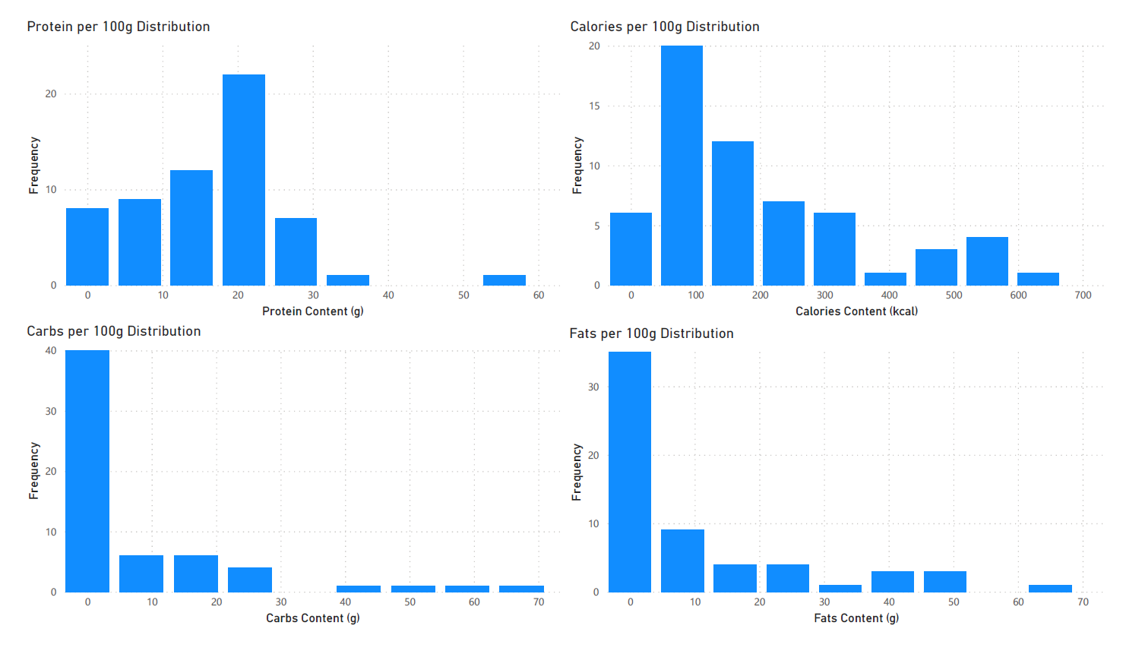
General Macros and Calories
Here protein distribution averages around 20g. Calories averages around 90 calories. Fats and Carbs average around 0g. We can see here that most foods that are considered high in protein have about 20g protein with less than 100 calories with close to 0g of carbs and fats.

Slide 6
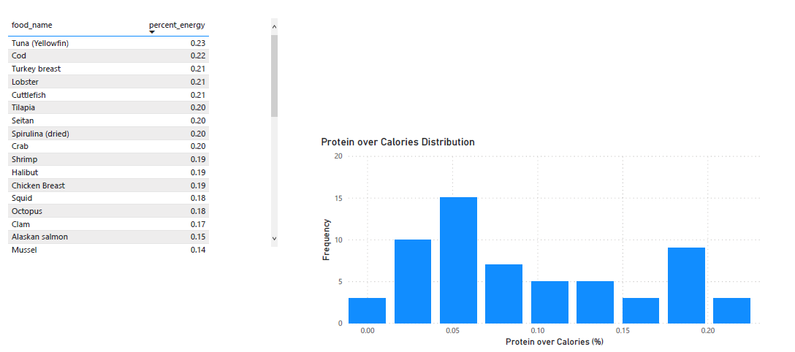
Proteins over Calories
Here we check to see which foods have the best ratio of protein over calories. Most of the foods have 10 percent protein to calorie ratio. The top 5 best food with the most protein for calories are Tuna, Cod, Turkey Breast, Lobster, and Cuttlefish. The first Vegetarian and Vegan option were Seitan and Spirulina (dried) being 7th and 8th respectively.

Slide 7
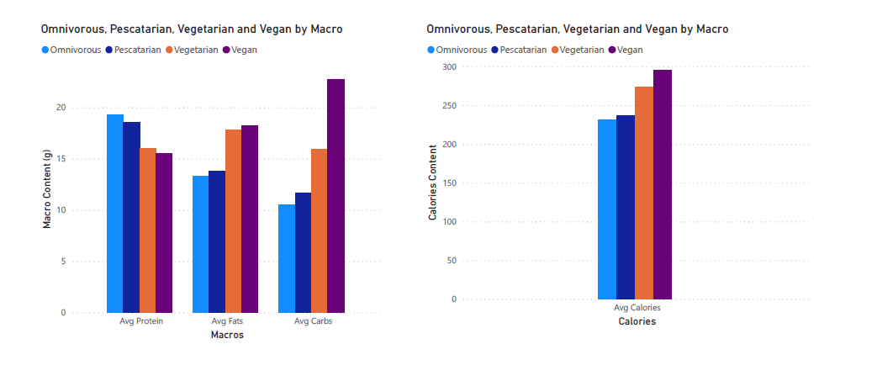
Diet Differences
Protein did not differ much between diets but the omnivorous diet had the highest protein content. Fats and carbs, and calories was surprising because the non-meat diets, Vegan and Vegetarian, had the most fats, carbs and calories.

Slide 8
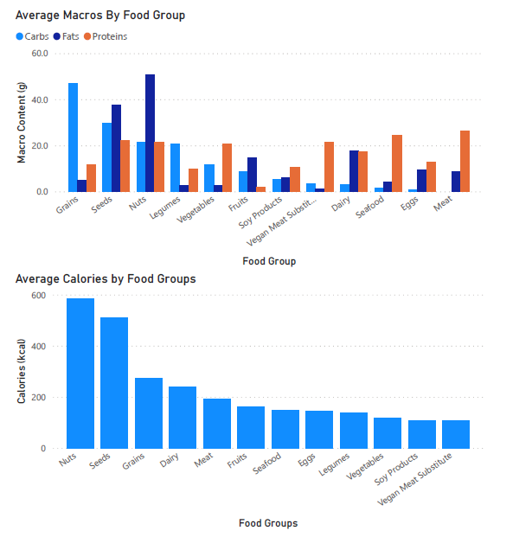
Food Groups
In the Calories graph all of the food groups have about equal calories except for Nuts and Seeds both being over 500 calories.

Slide 9
Applications of Data
If we want to focus primarily on losing weight we should look at food that is low in calories. Food groups such as Vegetables, Soy Products, and Vegan Products.
In working out we usually want to hit a protein target in order to reduce the risk of losing muscle while on a diet. Individuals with these goals should focus on foods that are have the best protein to calorie ratio.
Those with Vegan and Vegetarian Diets may have a harder time hitting protein target due to the fact that a lot of their high protein foods have a lot of calories in them.

